Slide 1
CLASS 6
Dated 29 th JANUARY , 2025
Course Title: 5G and Wireless Technology
Course Code : ECE829
MODULE 2 of the Syllabus:-
5G O-RAN / V-RAN Architecture with USE CASES
Prof.(Dr.) Rabindranath Bera (Professor, IIIT, KALYANI)
E-mail: rbera@iiitkalyani.ac.in; Mobile : 9475513358

Slide 2
Outline of Presentation
Overview of 5G Network and Architecture with Open and Virtualized RAN
Industrial Review
QUALCOMM DEMO : https://www.youtube.com/watch?v=e3Ad05I3LZU
Transcript
5G Architecture
5G Architecture ( BASIC)
5G Architecture ( with O-RAN and V-RAN)
5G O-RAN / V-RAN Architecture Design by QUALCOMM
5G USE CASES : 5G Architecture DEPLOYMENT
CTTC, Barcelona SECURED 5G O-RAN / V-RAN Architecture with TWO CELLS
QUALCOMM 5G O-RAN / V-RAN Architecture DEPLOYMENTS at SMART CITY with FOUR CELLS
IIIT,KALYANI 5G O-RAN / V-RAN Architecture DEPLOYMENTS over SEA/ISLAND Communication like Gangasagar with Five Cells

Slide 3
Outline of Presentation
Overview of 5G Network and Architecture with Open and Virtualized RAN
Industrial Review
QUALCOMM DEMO : https://www.youtube.com/watch?v=e3Ad05I3LZU
Transcript
Detailed 5G Architecture

Slide 4
TRANSCRIPT : Mobile World Congress MWC 2023 and today I have with me Durga maladi who is the senior vice president and general manager of modem and infrastructure at Qualcomm Technologies. Firstly Durga welcome thank you for being with me today this week at mwc. Qualcomm made several announcements focused on cellular infrastructure. How has qualcomm's infrastructure portfolio evolved to drive the development of the modern 5G Network. first of all very What is Qualcomms evolving infrastructure portfolio excited to be here and talking about infrastructure ask Qualcomm we made our very first announcement on the latest portfolio of solutions and infrastructure from us back in October of 2020. our message and our Focus has been to bring in cutting-edge high performance radios in both the DU and the ru portions of the solution in infrastructure space . the DU stands for the distributed unit and the ru is the radio unit these are two components that make up the foundational building blocks for infrastructure we feel that a cloud native architecture is needed in infrastructure as we head towards the next generation of where 5G is evolving as a part of that . we made a lot of announcements over the last two years but at this show we are bringing these products out here in the open and talking about all the key benefits that these products bring to the table it's Best in Class power and performance Cutting Edge radio Products on display and these are displays of some of the things that we talked about in our announcements. we have an entire distributed unit right here which runs at 200 megahertz and 16 layers this is something that we promised back about two years back that's on display right behind us along with a very low power consumption at 100 megahertz. we are at somewhere between 16 to 18 Watts they have 64 TR ,64 transmit and 64 received massive mimo radios the solution is on display over here and it's being displayed in a demonstration where we show 16 layers with four devices each with four layers each again Cutting Edge performance finally. In addition to the DU and aru space we made another announcement late last year on what we call as the compact macro solution this is a millimeter wave product which transmits at a very high transmit Power 60 dbm extending the range of millimeter wave but still keeping an extremely small form factor that's also on

Slide 5
displays over here it has the same form factor as a Wi-Fi access point but at the same time has very long range associated with it very powerful products and we are working with the entire ecosystem all of our partners to make sure that these come to commercialization we've seen several Strategic collaborations strategic collaborations between Qualcomm Global operators and ecosystem players over the past few months how is this how to accelerate open Rand Innovation and what are some of the benefits operators are realizing from them we've made a lot of announcements with our partners in the last two years but I'm going to actually cherry pick a few of them on the server space we are working closely with HP and Dell on the infrastructure vendors we are working with NEC Fujitsu mavenir rocket and Symphony vehicle just to name a few we're working with several others but with all these Partners our modern RS platforms are the foundational building blocks but a lot of the infrastructure Partners still have to do additional work in writing their layer 2 and layer 3 software and that makes it into a complete product as a part of these announcements we are working with several operators and in these operators what they are interested in is post these demonstrations and the lab tests we expect to see action on the ground in the field showcasing the technology showcasing what Oran compliant Solutions are really capable of when it comes to high performance radios and very energy efficient radios on top of it so we hope to prove this out into the field this year leading towards commercialization as we go along looking forward how is the growth Growth strategy strategy of Qualcomm Poe is to drive the full-scale commercialization of open virtualized brand from a general Qualcomm strategy when Cristiano took over as our CEO he made it very clear that we want to be in the business of diversifying our products into a large number of segments part of the diversification strategy is not only to expand on devices these days when we talk of devices we go from handsets compute segment fixed wireless access XR and going all the way into iot and Automotive domain but we want to bring in that Innovation onto the network side of the equation as well and that's where our diversification strategy really helps when we have a role not by being a full-fledged infrastructure vendor but by doing our part in having a horizontal platform on which our partners can build the radio Solutions as we move forwards we expect to see a larger portfolio of products coming into the mix as we grow from where we are today towards commercialization look thanks so much Outro for that very enlightening and it's great to see Qualcomm heading up such a fabulous ecosystem thank you thanks for having me

Slide 6
Outline of Presentation
Overview of 5G Network and Architecture with Open and Virtualized RAN
Industrial Review
QUALCOMM DEMO : Transcript
5G Architecture
5G Architecture ( BASIC)
5G Architecture ( with O-RAN and V-RAN)
5G O-RAN / V-RAN Architecture Implementation by QUALCOMM
5G O-RAN / V-RAN Architecture Implementation by IIIT, KALYANI

Slide 7
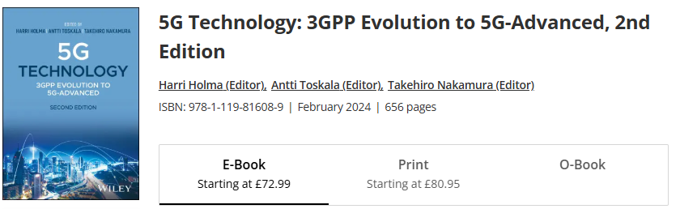
Chapter 5
5G Architecture
**The Softcopy of above BOOK will be uploaded in Classroom
*** Interested Teachers/Faculty should consult this Book on Requirement

Slide 8
Evolved Packet Core
(EPC)
5G Core
Evolved Packet Core (EPC)
with SA and NSA Mode

Slide 9
5G RAN Architecture
The 5G RAN radio access architecture consists of two basic elements as follows:
• Central Unit (CU), which is intended to handle relatively higher layers above the physical layer. The physical realization of CU could be either dedicated hardware or a radio-cloud type of implementation. The CU is connected on one hand to the Distributed Unit (DU) and on the other hand to the 5G core network (Next Generation Core (NGC), as shown in Figure 5.5.
• The DU, which is located on the cell site together with the antennas and the RF unit.The DU is expected to handle especially time-critical processing which does not tolerate too much delay to enable processing away from the cell site.
In the considerations in 3GPP, the approach with RF only on the site (with antennas)has not been considered desirable due to the very high transmission requirements of sending IQ samples.

Slide 10
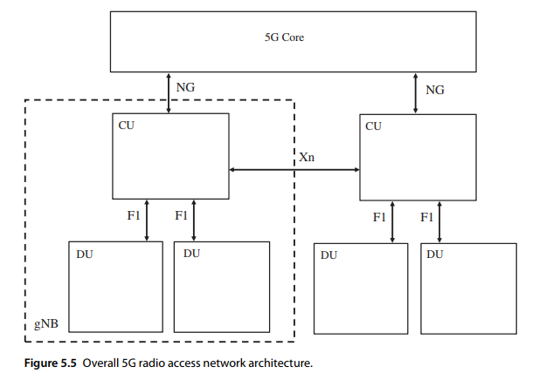

Slide 11
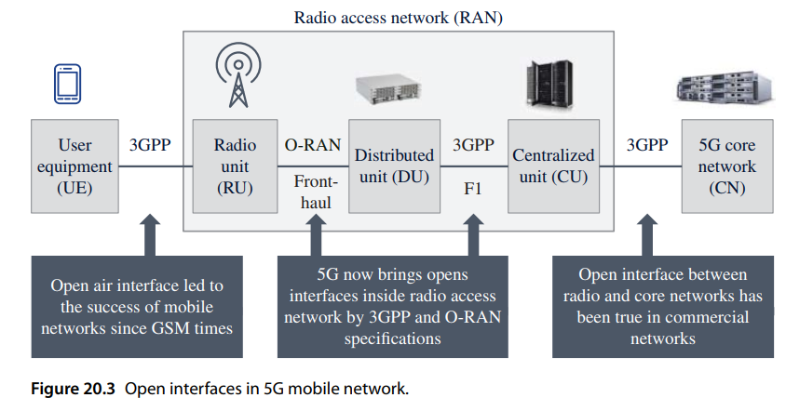

Slide 13
I-Q DATA PLANE
USB CONTROL PLANE

Slide 14
I-Q DATA PLANE
CONTROL PLANE
SENSING of
RECEIVED SIGNAL @ RECEIVER

Slide 15
REMOTE CONTROL of 60 GHz RADIO Transmitter Power after CSI sensing from Terminal to improve performance in Under served area

Slide 16
Channel estimation , CSI Feedback to SDAP Layer, Forwarded to RRC Layer and Passing CONTROL TO Radio Unit

Slide 17
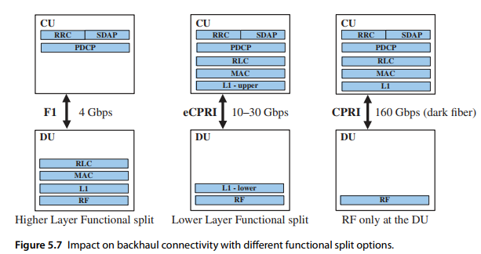
F1..ETHERNET
eCPRI..
USB 3 with Type C connector

Slide 18
*IIIT, KALYANI 5G LAB Set up has Split 7.2 Option

Slide 19
Outline of Presentation
Overview of 5G Network and Architecture with Open and Virtualized RAN
Industrial Review
QUALCOMM DEMO :
Transcript
5G Architecture
5G Architecture ( BASIC)
5G Architecture ( with O-RAN and V-RAN)
5G O-RAN / V-RAN Architecture Implementation by QUALCOMM
5G O-RAN / V-RAN Architecture Implementation by IIIT, KALYANI

Slide 20
Chapter 20
Open RAN and Virtualized RAN
Harri Holma and Antti Toskala
Nokia, Finland

Slide 21
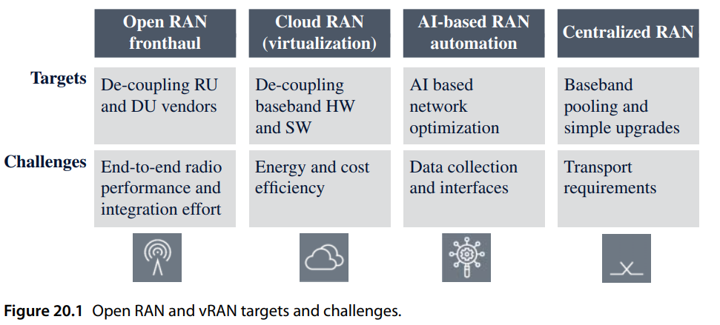
( DU and CU Vendors )

Slide 23
RECEIVER SECTION shown here

Slide 24
Outline of Presentation
Overview of 5G Network and Architecture with Open and Virtualized RAN
Industrial Review
QUALCOMM Transcript
5G Architecture
5G Architecture ( BASIC)
5G Architecture ( with O-RAN and V-RAN)
5G O-RAN / V-RAN Architecture Design by QUALCOMM
5G USE CASES : 5G Architecture DEPLOYMENT
CTTC, Barcelona 5G O-RAN / V-RAN Architecture with TWO CELLS
QUALCOMM 5G O-RAN / V-RAN Architecture DEPLOYMENTS with FOUR CELLS
IIIT,KALYANI 5G O-RAN / V-RAN Architecture DEPLOYMENTS with Five Cells

Slide 25








Slide 26


























































Open vRAN used in 5G Advanced ( 2nd Generation )

Slide 27










Place processing and analytics where it is needed
Simplify orchestration
Support different deployment scenarios
Resource pooling allows trunking gains and better cost and energy effectiveness
Rapidly scale virtual resources for additional capacity
Higher utilization of scalable resources
Why
Deploy networks faster
with vRAN and
disaggregation
Support lower
end-to-end latency
Components can evolve and be upgraded separately
Open vRAN
Efficiently deploy new services
Tailor dimensioning and features to suit the use case with 5G private networks
Reduce cell-site footprint by relocating disaggregated functions to data centers
Real Estate
Savings
Broaden the
ecosystem for competition
Build RAN cost-effectively
Vendor diversity spurs innovation
3

Slide 28


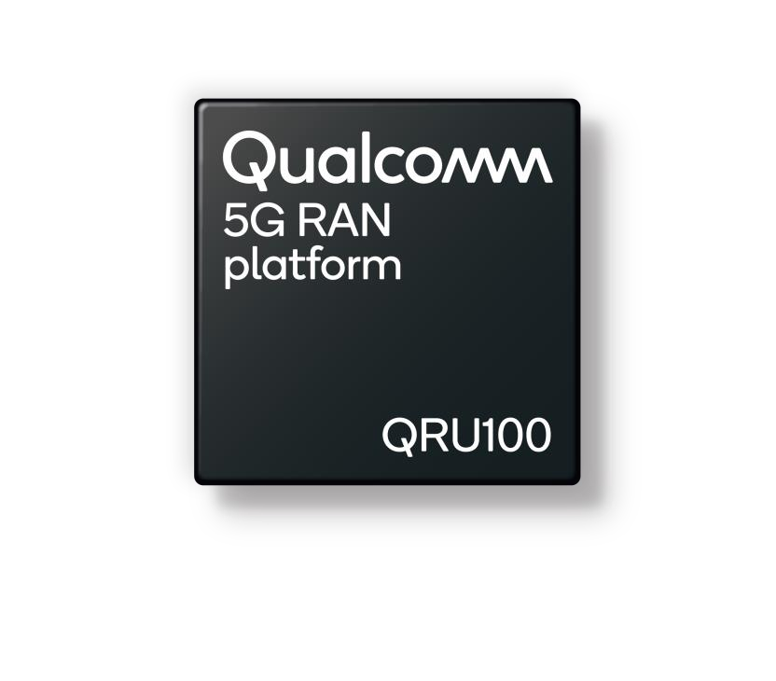
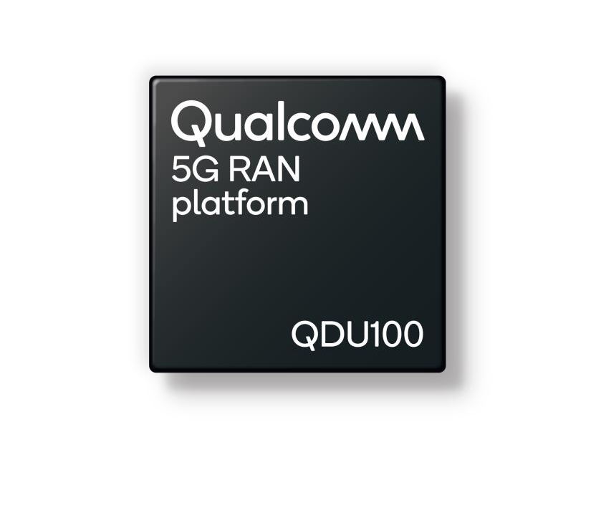
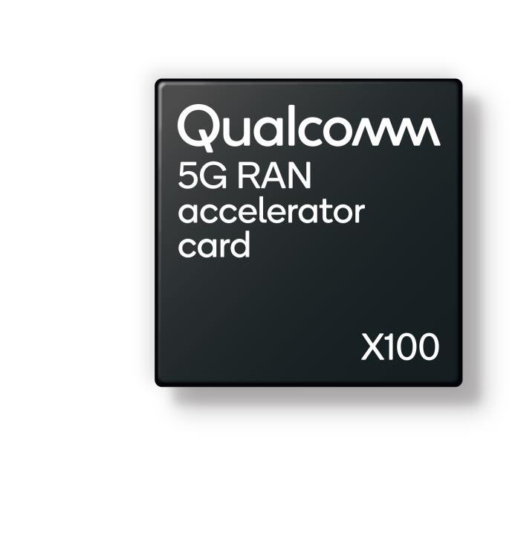


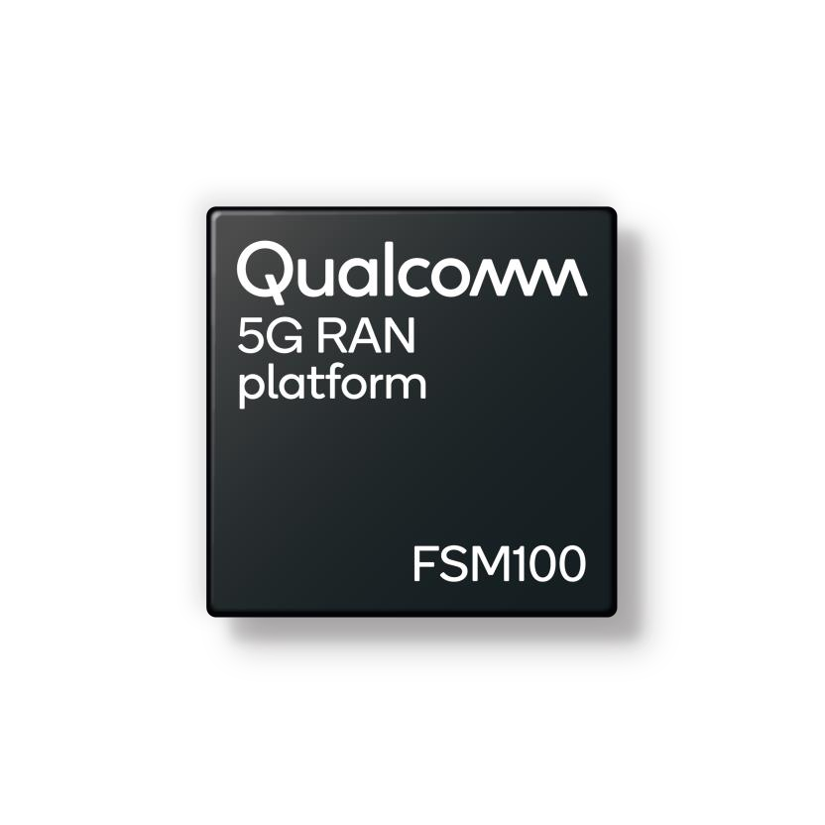





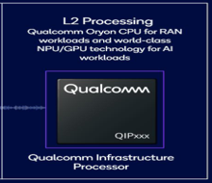



RADIO UNIT
DISTRIBUTED
UNIT
DU in ACC CARD
5G RAN SOC ( SYSTEM on CHIP)
CODING & MODULATION
SMALL CELLS
AI Processor

Slide 29
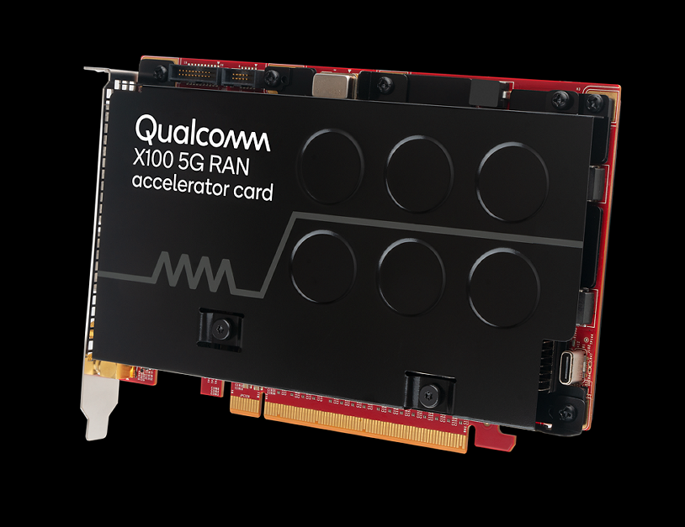
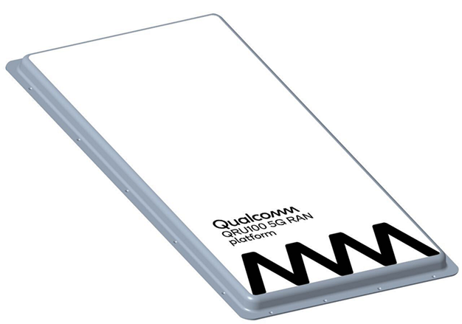
QUALCOMM DU CARD with QDU100 SOC
to be fitted on RAN 5G gNB SERVER
QUALCOMM RADIO UNIT RU
With QRU 100 SOC
QUALCOMM
5G CARDS/PRODUCTS
SMALL CELL with
FSM100/200 SOC

Slide 30













Collaborating with global operators to drive adoption of 5G Open vRAN commercial deployment
7

Slide 31




Driving the evolution to open, virtualized 5G RAN
Next-generation 5G virtual DU solution
First fully optimized vDU solution with up to 60% lower operator TCO
Solution aims to improve user experiences by helping ready virtualized and open RAN platforms to support the high- capacity and low-latency workloads of future networks.
* Total cost of ownership (TCO)
8

Slide 32
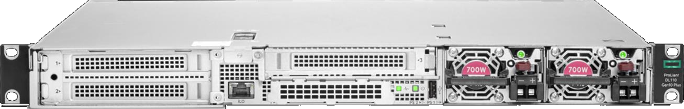

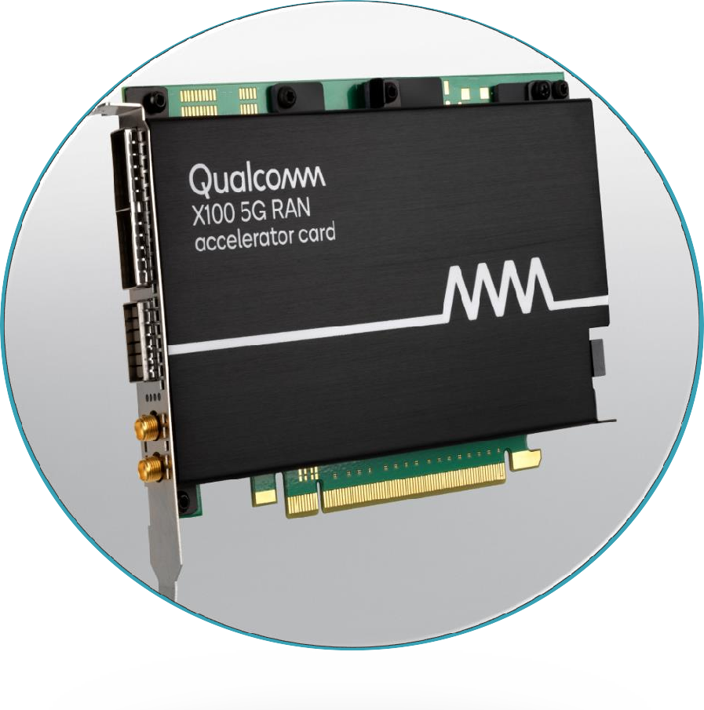



Qualcomm®
HPE ProLiant DL110 Gen10 Plus
X100 5G RAN Accelerator Card
Layer 1 Processing
Demodulation Beamforming Channel coding
Massive MIMO computation
1U server
Up to 4xM.2
NVMe
Front mounting
Front to back
active cooling
Shallow depth 17"
Up to 8 DIMMs
(8–128GB)
4xFHHL x16 PCIe 4.0
Single socket ICX-SP, up to 205W TDP
700W AC/ DC PSU
9

Slide 33
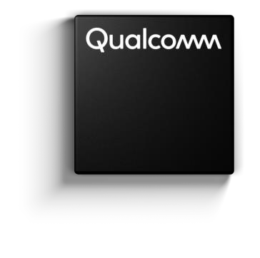






5G RAN
Platform
Next-generation 5G virtual DU solution
up to
up to
60% 40%
First fully optimized vDU solution
Lower Operator TCO
Lower power consumption
10

Slide 34

Driving the evolution to open, virtualized 5G RAN
Next-generation 5G DUs and RUs with massive MIMO for Open RAN 5G deployments
Solutions to enable the deployment of cloud-native, virtualized, and open 5G networks at scale
Solution Powered by Qualcomm® 5G RAN Platforms is Designed to Simplify Network Deployments, Lower TCO, and Accelerate Adoption of Cloud-Native, Open RAN-Based Mobile Networks Globally
11

Slide 35

Driving the evolution to open, virtualized 5G RAN
a vDU solution, built with Mavenir vDU RAN software and powered by Qualcomm X100 5G RAN Accelerator Card
12

Slide 36


Driving the evolution to open, virtualized 5G RAN
Fujitsu will be unveiling an O-RAN compliant 64TRX Massive MIMO Radio Unit, powered by Qualcomm QRU100 5G RAN platform
13

Slide 37
Viettel Launches the World’s First O-RAN 5G Network Utilizing Qualcomm 5G RAN Platforms
Viettel said it will deploy more than 300 sites across various Vietnamese provinces by the first quarter of 2025
Vietnamese telco Viettel announced the commercial launch of its Open RAN (O-RAN) 5G network using a platform provided by Qualcomm Technologies, the company said in a release.
The telco claimed that this is the first O-RAN 5G network utilizing Qualcomm Technologies’ 5G RAN platforms. Viettel said it will deploy over 300 sites across various Vietnamese provinces by the first quarter of 2025, with the potential for thousands more as part of nationwide and international expansion plans in 2025 and beyond, said Viettel.
The deployment utilizes Qualcomm X100 5G RAN Platform for vDUs, Qualcomm QRU100 5G RAN platform for Massive MIMO radio units and integrates the Qualcomm Edgewise Suite for premium RAN management.
https://www.rcrwireless.com/20241114/featured/viettel-qualcomm-5g-o-ran

Slide 38
Outline of Presentation
Overview of 5G Network and Architecture with Open and Virtualized RAN
Industrial Review
QUALCOMM DEMO :
Transcript
5G Architecture
5G Architecture ( BASIC)
5G Architecture ( with O-RAN and V-RAN)
5G O-RAN / V-RAN Architecture Design by QUALCOMM
5G USE CASES : 5G Architecture DEPLOYMENT
CTTC, Barcelona SECURED 5G O-RAN / V-RAN Architecture with TWO CELLS
QUALCOMM 5G O-RAN / V-RAN Architecture DEPLOYMENTS at SMART CITY with FOUR CELLS
I[ MODULE 3 of SYLLABUS [ Detailed will be discussed Later] KALYANI 5G O-RAN / V-RAN Architecture DEPLOYMENTS over SEA/ISLAND Communication like Gangasagar with Five Cells

Slide 39
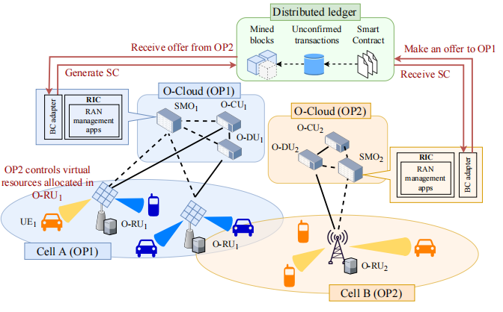
Fig. BlockChain enabled RAN sharing ecosystem with TWO CELLS at CTTC, Barcelona towards ADDED Wireless TRUST and SECURITY

Slide 40
Outline of Presentation
Overview of 5G Network and Architecture with Open and Virtualized RAN
Industrial Review
QUALCOMM DE
Transcript
5G Architecture
5G Architecture ( BASIC)
5G Architecture ( with O-RAN and V-RAN)
5G O-RAN / V-RAN Architecture Design by QUALCOMM
5G USE CASES : 5G Architecture DEPLOYMENT
CTTC, Barcelona SECURED 5G O-RAN / V-RAN Architecture with TWO CELLS
QUALCOMM 5G O-RAN / V-RAN Architecture DEPLOYMENTS at SMART CITY with FOUR CELLS
IIIT,KALYANI 5G O-RAN / V-RAN Architecture DEPLOYMENTS over SEA/ISLAND Communication like Gangasagar with Five Cells

Slide 41





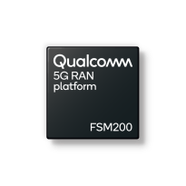

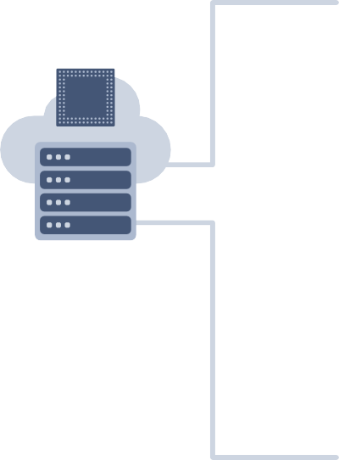


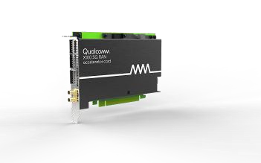



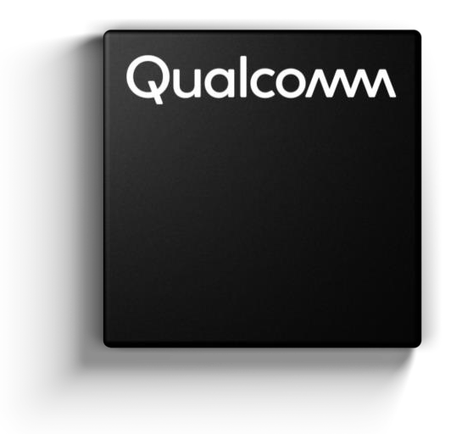

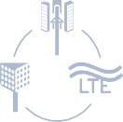



Driving transition to Infrastructure 2.0
Powered by extended portfolio of Qualcomm® 5G RAN platforms
with FOUR PRIVATE CELLS
Standard-based open RAN interfaces
Sub 6 GHz
RADIO
Qualcomm
High-performance Modem-RF System
10101 10101 10101
10100 10100 10100
01010 01010 01010
11010 11010 11010
Virtualized software from multiple vendors
SMALL
CELLs
Internet and 3rd party cloud
Edge data centers
5G-gNB (DU)
with CODING &
MODULATION &
Others
Includes
* 5G CORE
* MEC
General-purpose COTS hardware
EXTREME BROAD BAND using MM Wave RADIO
5G RAN
Platforms
High performance Modem-RF System
Flexible, scalable, O-RAN compatible
vRAN with hardware acceleration
Designed for macro and small cells
Integrated mmWave and Sub-6 GHz solution with
global band support

Slide 42


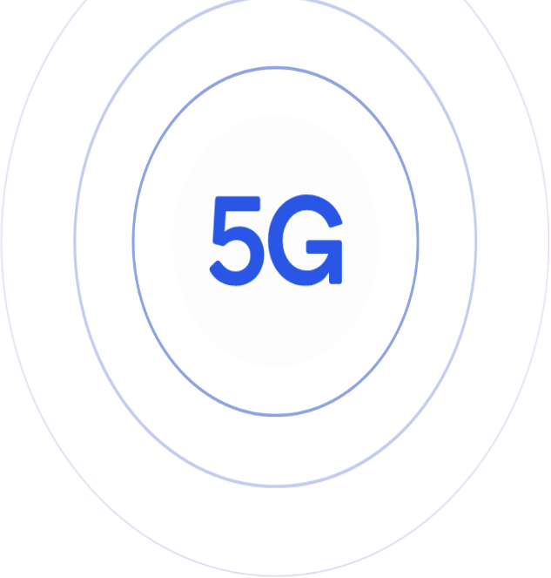








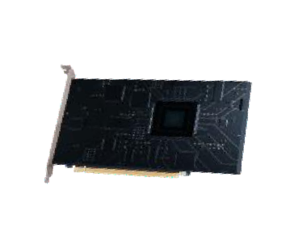












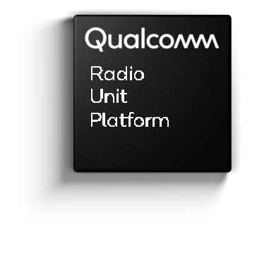











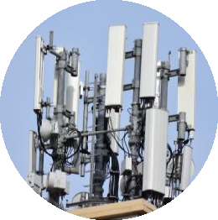
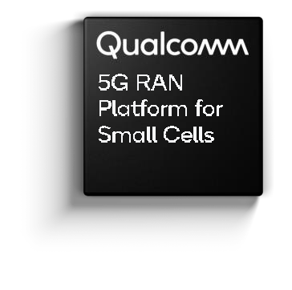











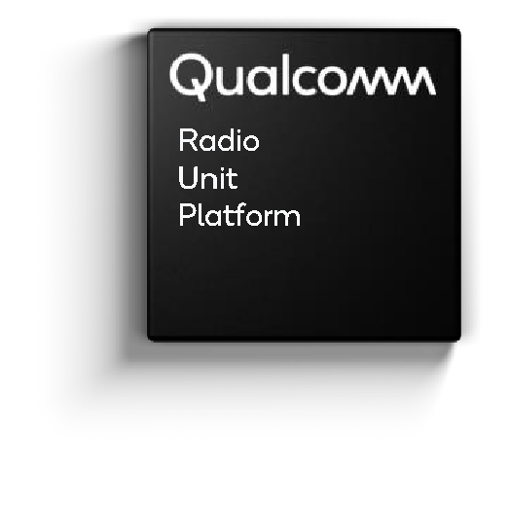



5G Infrastructure 2.0 with PUBLIC & PRIVATE NETWORK ADD-ON
5G OPEN- vRAN PRIVATE NETWORK
ADD-ON
Core Data
Center
RAN Data
Center
RAN Data Center
Small Cells
EXISTING 5G NETWOTK
6

Slide 43
Outline of Presentation
Overview of 5G Network and Architecture with Open and Virtualized RAN
Industrial Review
QUALCOMM DEMO
Tcript
5G Architecture
5G Architecture ( BASIC)
5G Architecture ( with O-RAN and V-RAN)
5G O-RAN / V-RAN Architecture Design by QUALCOMM
5G USE CASES : 5G Architecture DEPLOYMENT
CTTC, Barcelona SECURED 5G O-RAN / V-RAN Architecture with TWO CELOM-RAN / V-RAN ArchitMODULMODULE 4 of SYLLABUS [ Detailed will be discussed Later] ENTSwith FOUR CELLS
IIIT,KALYANI 5G O-RAN / V-RAN Architecture DEPLOYMENTS over SEA/ISLAND Communication like Gangasagar with Five Cells
Design and Deployment of 5G-Advanced Infrastructure 2.0 based Private Network at nearby areas surrounding Gangasagar Island

Slide 45
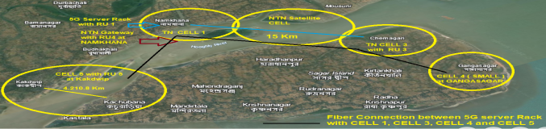
IIIT,KALYANI 5G O-RAN / V-RAN Architecture DEPLOYMENT with Five Cells
Fig : Private virtualized 5G-Advanced network at or nearby Gangasagar Island to solve majority of Communication problems of Under-served /unserved water channel and Crowded areas at Kapil Muni Temple, Gangasagar .

